Slide 1



FOOD DONATION SYSTEM (ETAAM) GRADUATION PROJECT
Fayoum University
Faculty of Science
Mathematics Department
Math and Computer Science Branch
Supervisor Dr. Mohamed Abdelbaky
Date of examination 23/8/2020

Slide 2
TEAM MEMBERS
Osama Mohamed Shawky Abdallah
Rabab Eid Abdulrahman Ewis
Fady Nabil Samy Gouda
Abdulrahman Mahmoud Hashem

Slide 3




INTRODUCTION

Slide 4

FOOD WASTE

Slide 5

FOOD WASTE

Slide 6
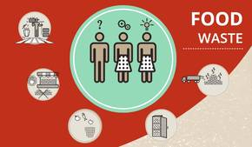

INTRODUCTION
33% to 50% of food is wasted
1.3 billion tons
800 million people VS hunger
250 kg for one person
Notes:
يبلغ الفاقد من الأغذية والهدر الغذائي سنوياً 1.3 مليار طنّ أو ثلث إجمالي الأغذية المنتجة عالميا. والعالم لا يزال فيه حوالي 800 مليون شخص يعانون من الجوع (تقرير الأمم المتحدة عن الجوع في سنة 2014)، يشكل خفض الفاقد من الأغذية والهدر الغذائي عاملاً أساسياً لتحقيق الأمن الغذائي في العالم ونظم غذائية مستدامة.

Slide 7
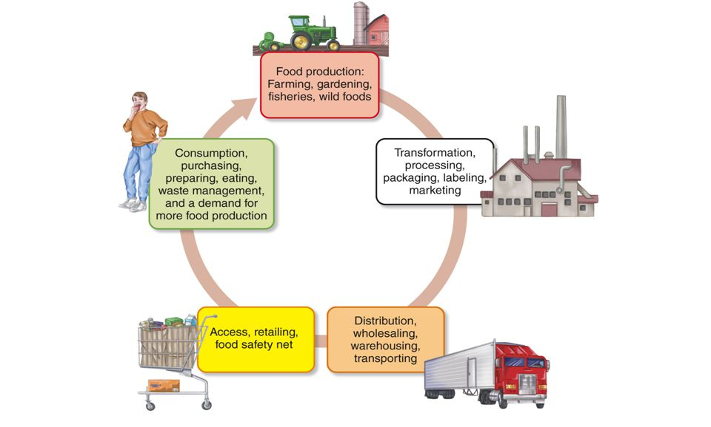
FOOD PRODUCTION PROCESS
Time
Energy
Money
Resources

Slide 8
SDLC
Requirement gathering and analysis
Design
Implementation
Testing
Deployment & Maintenance

Slide 9
INFORMATION GATHERING
User Interviews Mrs. Hanna Mohamed / Fayoum University central library officer Do you face the problem of waste food in your daily life?
Yes, but as much as possible we try to buy food that is sufficient for our need only. How you deal with waste food?
I usually collect them and use the as animal feed.
Chef. Asmaa / Fayoum University hotel How much food do you have here at the hotel?
Almost 40% of carbohydrate, and 10% of meat. Do you have a way to reduce waste food?
Unfortunately not, we get rid of it .

Slide 10
PROBLEM DEFINITION
Hotels and restaurants have a high average of waste food, and on the other side of the spectrum many people suffer from hunger and food shortage, many charities are trying to lend them a helping hand but numbers are increasing.
Solution: Building a platform that enables hotels and restaurants to share food before it get rid of it with charities that has a database with poor people who deserve food meals, also the platform includes doctors to check the quality of food and drivers for transporting.

Slide 11



SCOPE

Slide 12
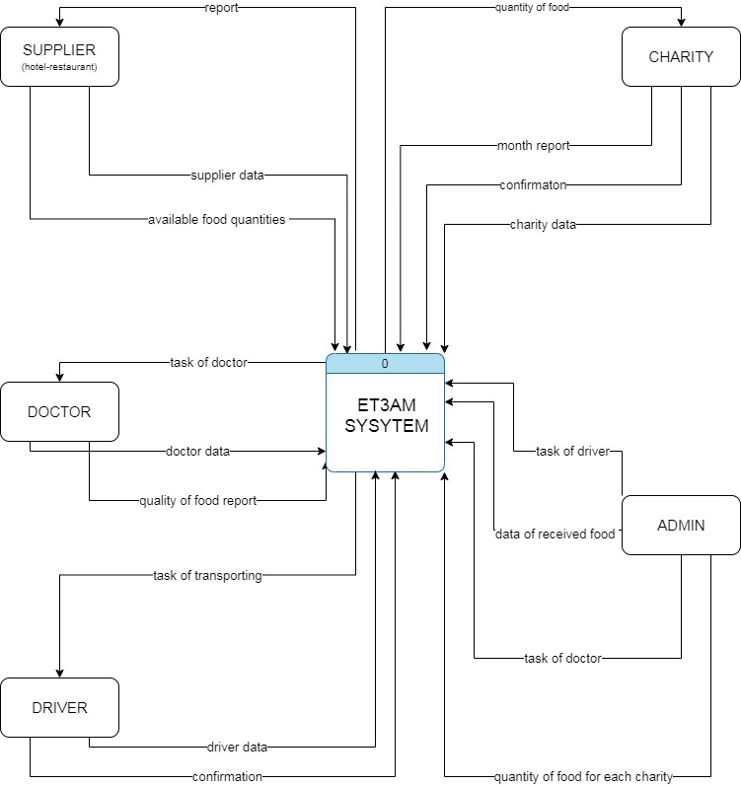
SYSTEM ARCHITECTURE
Data flow diagram (context level) A data flow diagram (DFD) illustrates how data is processed by a system in terms of inputs and outputs. As its name indicates its focus is on the flow of information, where data comes from, where it goes and how it gets stored.

Slide 13
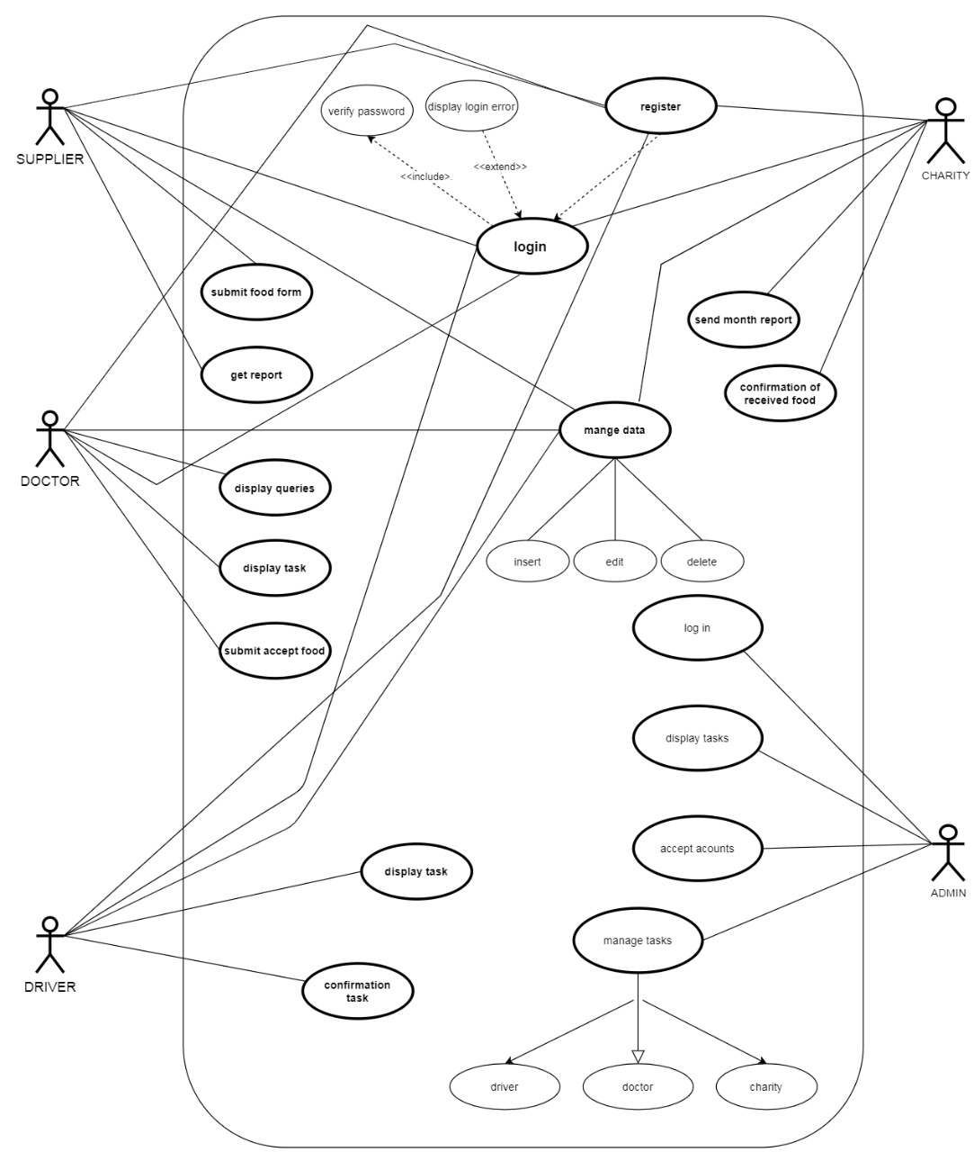
Use Case Diagram Use case diagrams model the functionality of a system using actors and use cases. Use cases are a set of actions, services, and functions that the system needs to perform. In this context, a "system" is something being developed or operated, such as a web site. The "actors" are people or entities operating under defined roles within the system

Slide 14
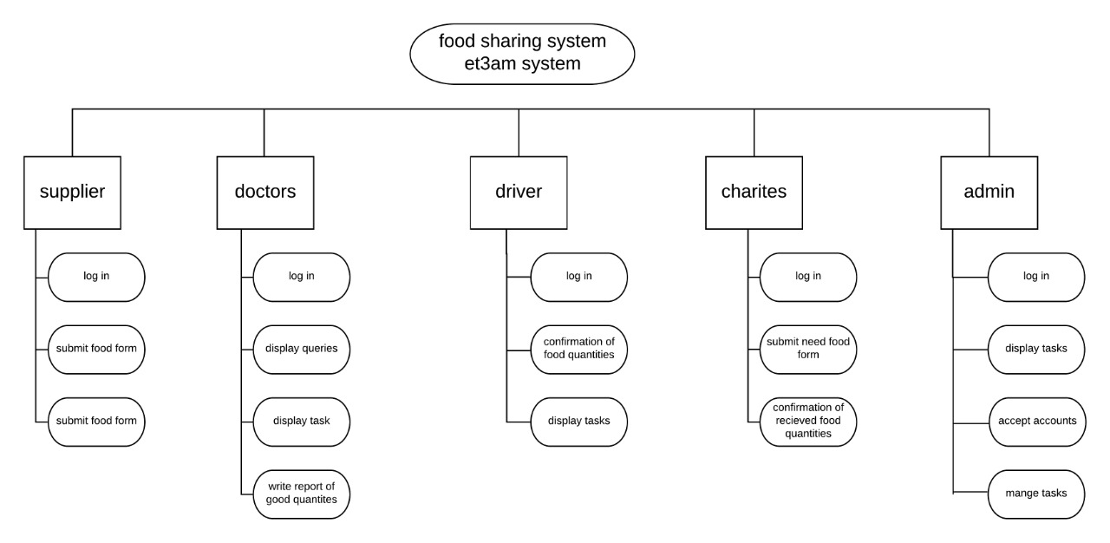
Functional Decomposition Diagram (FDD) Functional decomposition corresponds to the various functional relationships as how the original complex business function was developed. It mainly focusses on how the overall functionality is developed and its interaction between various components.

Slide 15
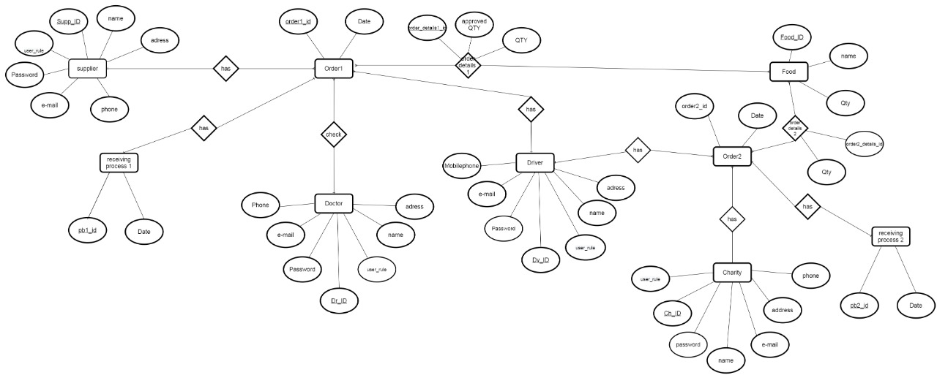
Entity Relationship Diagram (ERD) An entity relationship diagram (ERD) shows the relationships of entity sets stored in a database. An entity in this context is an object, a component of data. An entity set is a collection of similar entities. These entities can have attributes that define its properties.

Slide 16
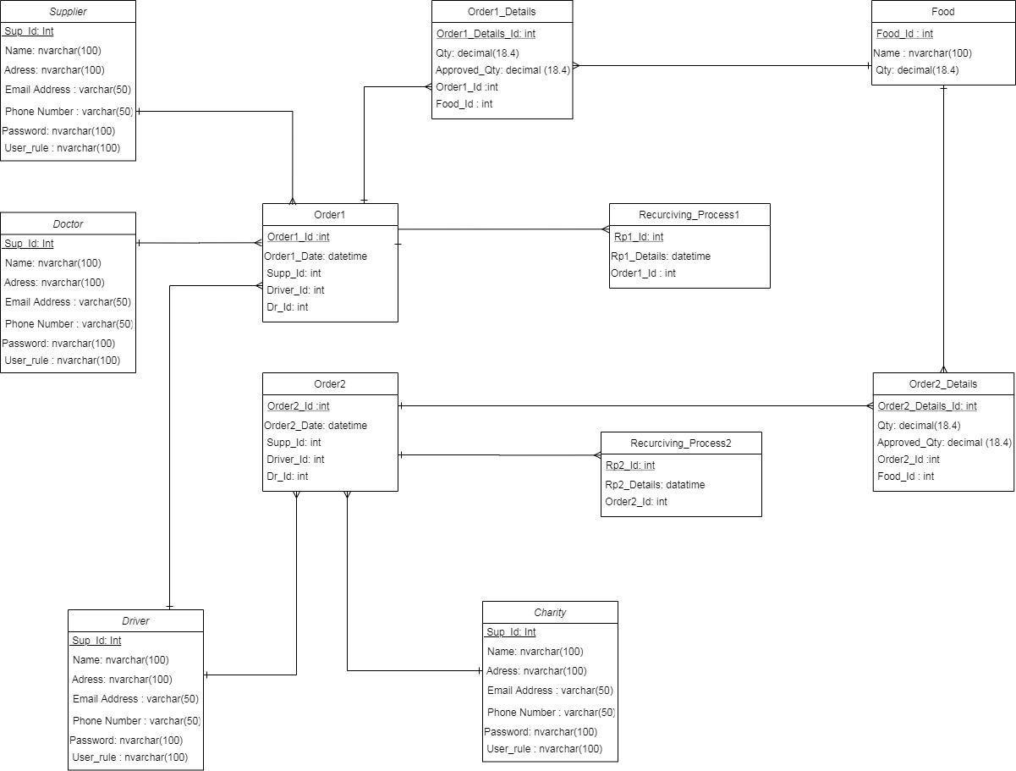
Class Diagram A class diagram models the static structure of a system. It shows relationships between classes, objects, attributes, and operations.

Slide 17
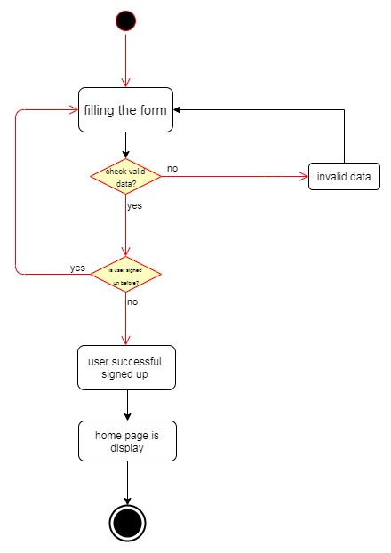
Activity Diagram An activity diagram visually presents a series of actions or flow of control in a system similar to a flowchart or a data flow diagram. Activity diagrams are often used in business process modeling. They can also describe the steps in a use case diagram. Activities modeled can be sequential and concurrent. In both cases an activity diagram will have a beginning (an initial state) and an end (a final state).
Activity Diagram (Sign Up)

Slide 18
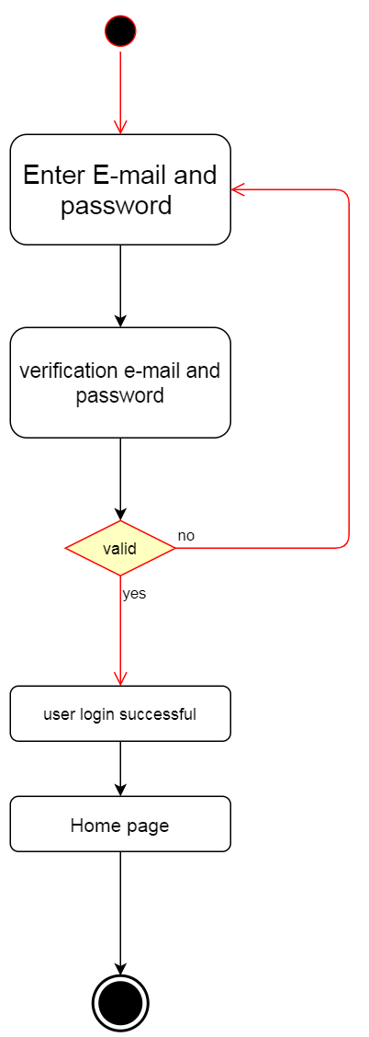
Activity Diagram (log in)

Slide 19
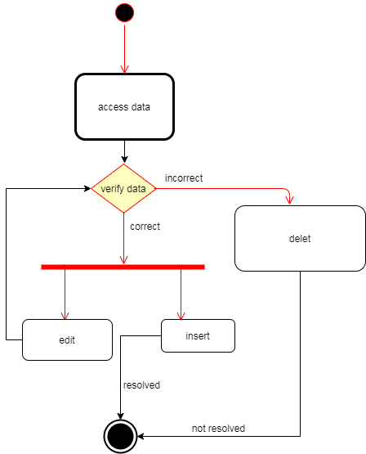
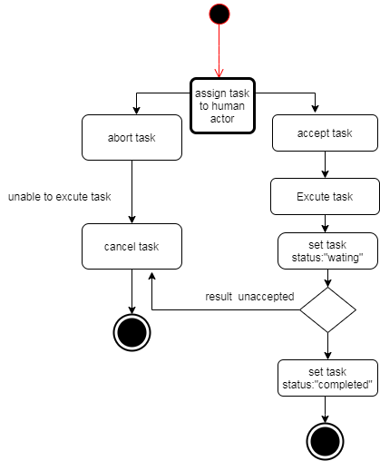
Activity Diagram (Manage Data)
Activity Diagram (Manage Task)

Slide 20
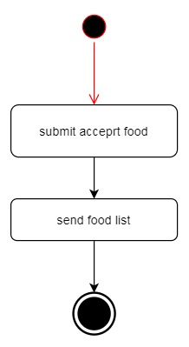
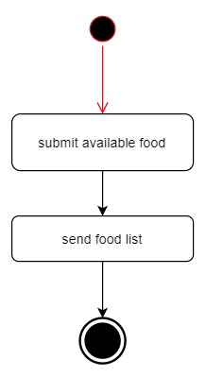
Activity Diagram (Submit Accepted Food)
Activity Diagram (Submit Available Food)

Slide 21
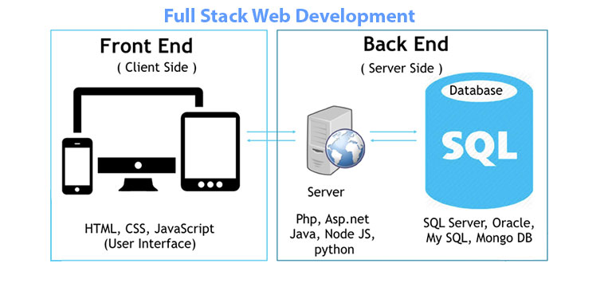
TECHNOLOGIES USED

Slide 22


TECHNOLOGIES USED
Front End Technologies

Slide 23






TECHNOLOGIES USED
Back End Technologies

Slide 24

TECHNOLOGIES USED
Android Technologies

Slide 25
THANK YOU
Any Questions?

